Slide 1

The scholars
Taniya Dixit | 2026 | Delhi Technical Campus , IPU
Priyanshu patial | 2026 | Delhi Technical Campus , IPU
Sahil | 2026 | Delhi Technical Campus , IPU
Khushal | 2026 | Delhi Technical Campus , IPU

Slide 2
About
Worked on Various LLM Based projects for summarizations , coding Chatbots etc
Participated in Build India Hackathon developed a Real time traffic detection Model
Awarded as Third position in IOT-ML based hardware project in Ai department from inter college competions.

Slide 3
Problem statement
Overview of your solution
Our solution is an LLM-powered query–response system designed to process natural language queries and retrieve precise answers from large, unstructured documents such as policies, contracts, and emails. It combines semantic search with Large Language Model reasoning to not only locate relevant clauses but also interpret them, apply business logic, and deliver structured, explainable results
Process Flow
1. User Query Input – User enters a natural language question.
2. Entity Extraction – AI parses the query to identify key details (e.g., age, location, policy
duration).
3. Document Preprocessing – PDFs, Word files, or emails are cleaned, split into chunks,
and vectorized.
4. Semantic Search – Vector database (FAISS/Pinecone) finds contextually relevant clauses.
5. LLM Reasoning – Model interprets the clauses, applies rules, and makes a decision.

Slide 4
Tech Stack
Programming Language: Python
Frameworks & Libraries:
LangChain – LLM orchestration & prompt management
OpenAI API / HuggingFace Transformers – LLM access & NLP models
PyMuPDF / pdfplumber – PDF text extraction
Pandas – Data handling & transformation
Vector Database: FAISS / Pinecone – Semantic search & embeddings storage
Frontend: Streamlit / Flask – Interactive UI for queries and results
Models: GPT-4, LLaMA 2/3, or domain-specific fine-tuned models
Other Tools:
spaCy – Named Entity Recognition (NER)
tiktoken – Tokenization for chunking text efficiently

Slide 5
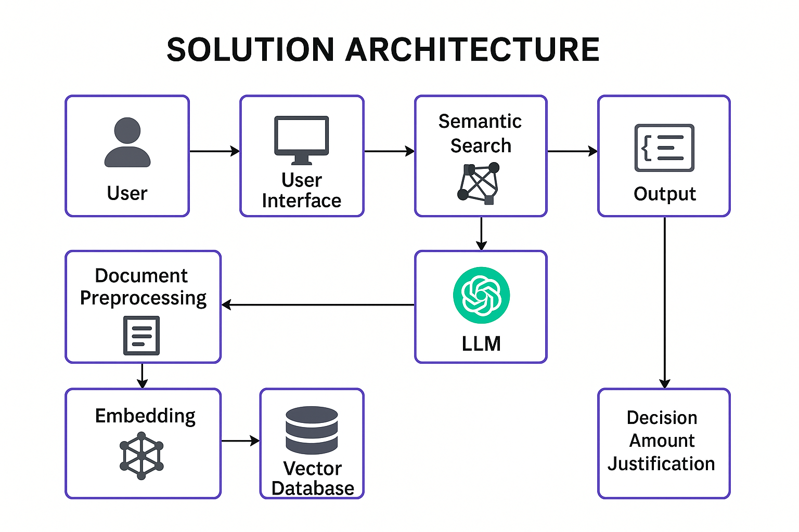
Description of the solution
Architecture

Slide 6
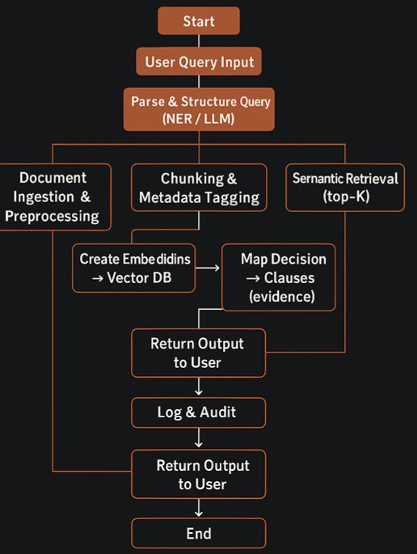
FLOWCHART

Slide 7
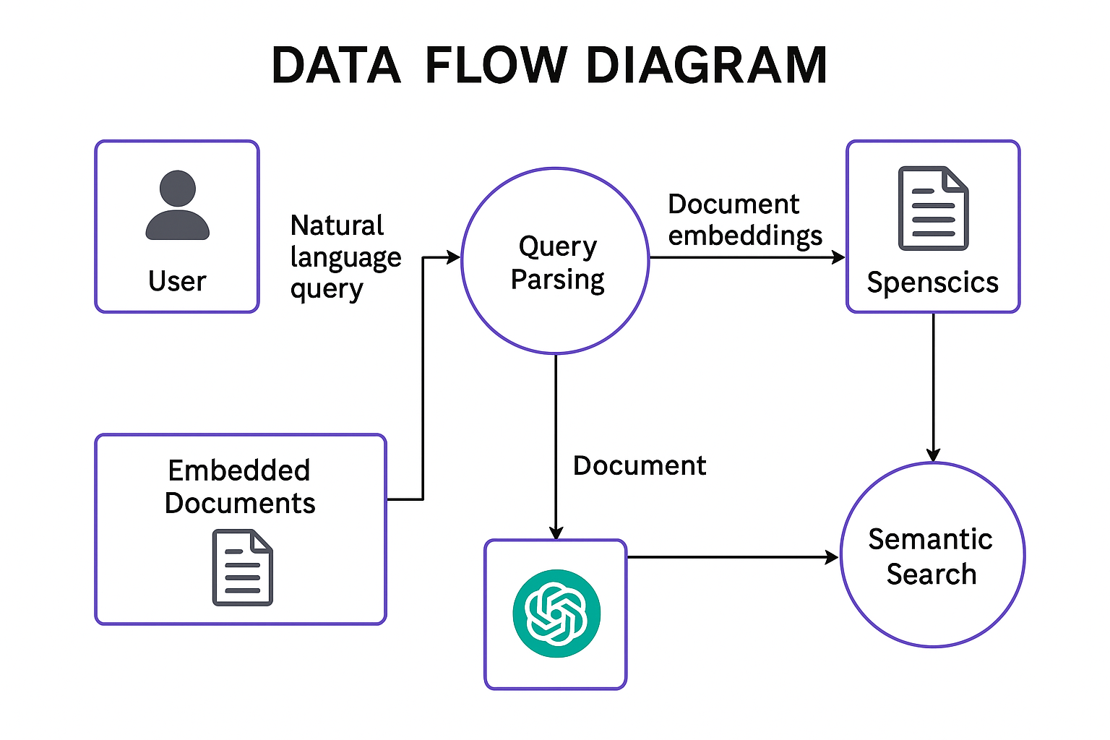
Data Flow Diagram
Data Flow of your solution

Slide 8
Our solution is different?
Our solution uniquely combines LLM-powered intelligence with unstructured document processing to deliver highly accurate, context-aware answers in real time. Unlike conventional keyword-based search, it understands the intent of queries, adapts to diverse document formats, and continuously improves through feedback. This ensures faster insights, minimal manual effort, and scalable integration across industries.

Slide 9
Future possible enhancements
Multilingual Support – Extend query understanding and responses to multiple languages for global applicability.
Voice-based Query Handling – Integrate speech-to-text and text-to-speech for hands-free interactions.
Advanced Summarization – Add abstractive summarization to condense large documents into key points.
Real-time Document Ingestion – Enable instant processing of newly added files without re-indexing.
Domain-specific Fine-tuning – Create specialized LLM models for legal, medical, financial, and technical documents.
Integration with Enterprise Tools – Seamless linking with Slack, Teams, Notion, and other workplace platforms.
Enhanced Data Security – Implement advanced encryption and on-premise deployment for sensitive data handling.

Slide 10
Risks
Data Privacy & Compliance – Handling sensitive documents (e.g., medical, legal) must comply with GDPR, HIPAA, or other regulations.
Model Accuracy & Hallucination – LLMs may generate confident but incorrect answers if retrieval context is insufficient.
Computational Cost – High usage of large models like GPT-4 can lead to significant operational costs.
Document Quality Variance – Poorly scanned PDFs or inconsistent formatting can reduce extraction accuracy.
Latency Issues – Large document sets and complex queries can impact response time without optimized retrieval.
Dependency on External APIs – Reliance on third-party LLM APIs (OpenAI, Anthropic) may pose risks if pricing, availability, or policies change.
Continuous Maintenance – Need for regular updates to embeddings, vector DB, and fine-tuning to maintain accuracy over time.

Slide 11
Acceptance Criteria Coverage
Accurate Query Parsing – The system must correctly identify and structure key details (age, location, procedure, policy duration, etc.) from varied natural language inputs.
Relevant Information Retrieval – Retrieved document clauses must be semantically related to the query, not just keyword matches.
Correct Decision Logic – The output decision (approval/rejection, payout amount) must align with the rules in the source clauses.
Clause Mapping in Output – Every decision must reference the exact clause(s) it is based on.
Structured JSON Output – Responses must be returned in a consistent, machine-readable JSON format.
Multi-format Document Support – System should process PDFs, Word docs, text files, and email bodies.
Performance Benchmarks – Retrieval + reasoning should occur within defined time limits (e.g., under 5 seconds for medium datasets).
User Interface Usability – The web/app interface must allow easy query entry, display results clearly, and highlight referenced clauses.
Error Handling – Graceful handling of incomplete queries, unsupported file formats, or missing data without system crashes.
Security Compliance – Data handling must meet agreed privacy and security standards.

Slide 12
Conclusion
Our solution is modular and scalable, allowing individual components (document ingestion, semantic search, reasoning engine, UI) to be upgraded or replaced without affecting the whole system.
It supports plug-and-play LLMs — meaning you can switch between GPT-4, Claude, LLaMA, or custom fine-tuned models based on cost, speed, or accuracy needs.
The architecture is cloud-ready but can also be deployed on-premise for sensitive or regulated industries.
It’s designed with continuous learning capabilities — user feedback can be used to retrain ranking models for improved retrieval accuracy over time.
Built to integrate with existing enterprise workflows (Slack, Teams, CRM systems, and document management platforms).
Includes comprehensive logging and analytics to monitor system performance, query patterns, and decision explanations for transparency and auditing.

Slide 13
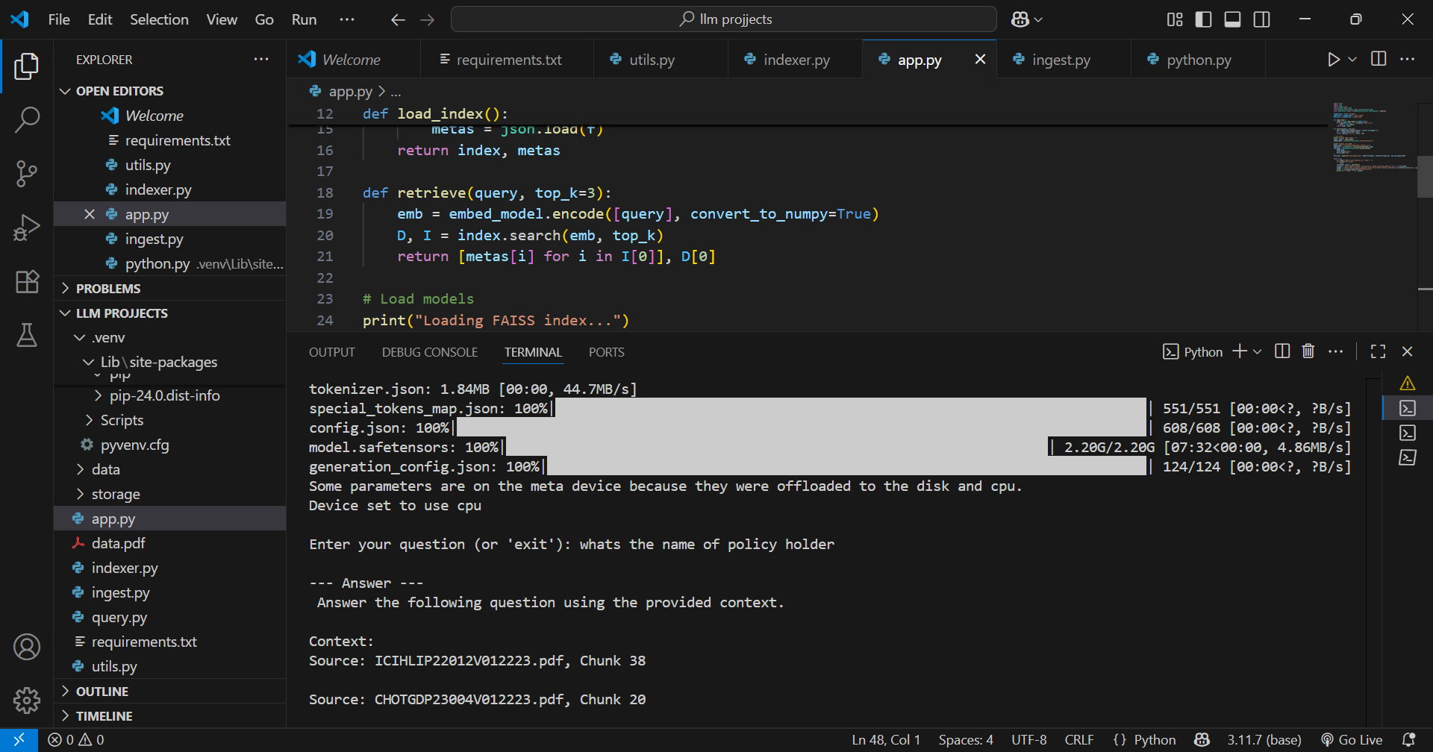
Code example

